Slide 1
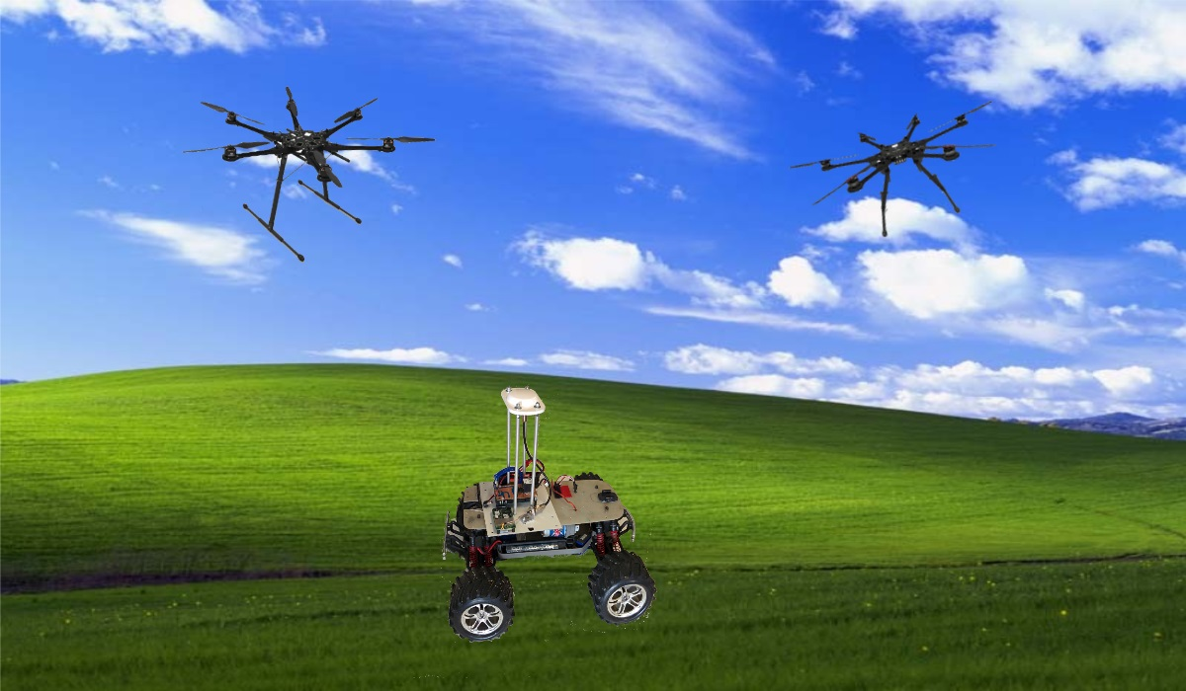
Navigation Board A
Navigation Board B
S800
+
Stabilization and Position Autopilot
S800 EVO
+
Stabilization and Position Autopilot
GPS
Board
ROVER

Slide 2
Multirotor follower
Rover leader

Slide 3
Multirotor follower
Rover leader

Slide 4
Multirotor 1 follower
Multirotor 2 follower
Rover leader

Slide 5
GPS
+
Compass
Receiver
Navigation Board A
S800
Pilot Commands
Arduino Based Board
Drone A Position
Stabilization
Position
Autopilot
Vx, Vy, Vz
Radio link
Navigation
Law
Drone B Position
Rover Position

Slide 6
GPS
+
Compass
Receiver
Navigation Board B
S800 EVO
Pilot Commands
Arduino Based Board
Drone B Position
Stabilization
Position
Autopilot
Vx, Vy, Vz
Radio link
Navigation
Law
Drone A Position
Rover Position

Slide 7
GPS
Rover Board
Rover
Arduino Based Board
Receiver
GPS Position To Drone A
Radio link
GPS Position To Drone B
Navigation
Law

Slide 8
HARWARE
Component | Cost
Navigation Board A | 1000 €
Navigation Board B | 1000 €
Rover Board | 900 €
 | 2900 €
Activities
Activity | Weeks
Hardware assembly and testing | 3
Driver Sensors and I/O | 4
Navigation Law Integration and Codification | 4
Broadcast Telemetry | 4
Firmware integration | 4
Test | 3
 | 22 weeks

